Slide 1
CISC3003-Project-Assignment Individual Part: Implementing a Simple Shopping Cart System with PHP PDO and MySQL Database
Huang Yanzhen, DC126732

Slide 2
Introduction
This project aims to implement a simple shopping cart system with the following functions
Adding products into Product View
Adding products listed in Product View into Shopping Cart
Alternatively, directly place an order in Product View
Placing an order in Shopping Cart
Alternatively, delete products in the Shopping Cart

Slide 3
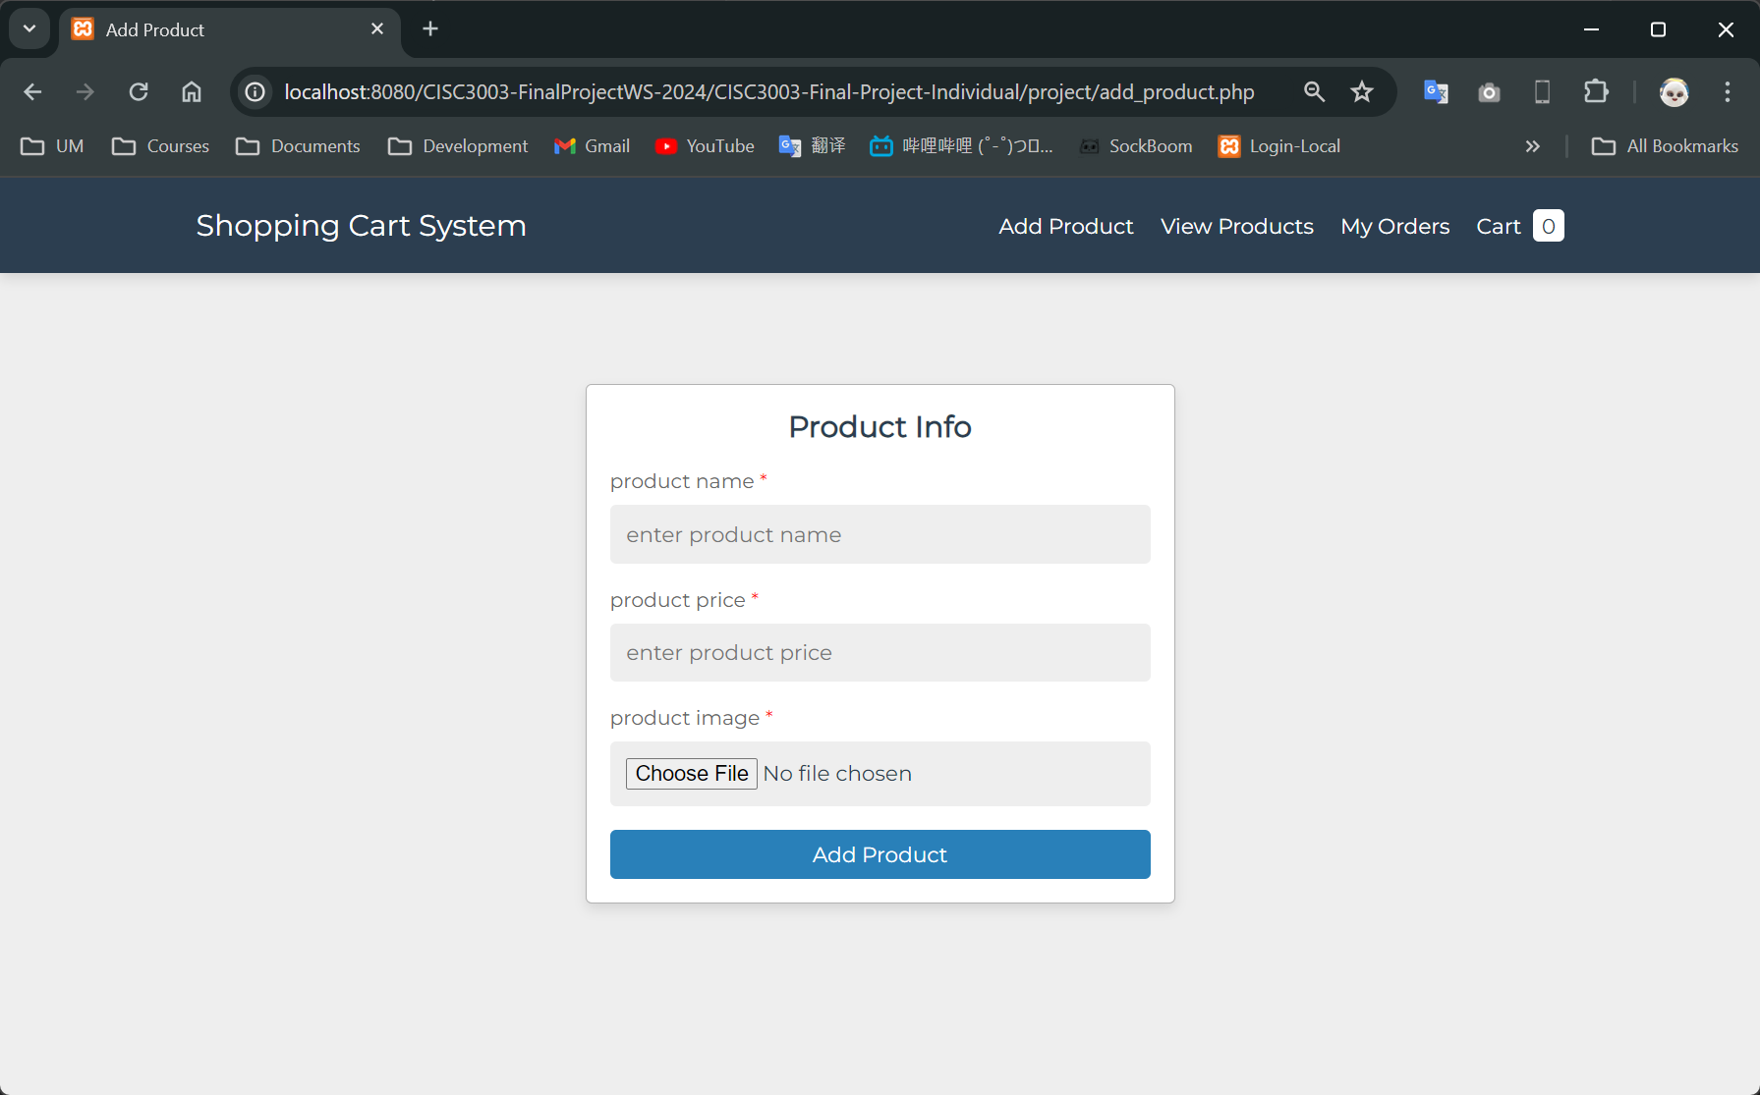
Functions / Add Product
To add a product, a user
Specifies the name of the product
Specifies the price of the product
Uploads the webp image file of the product

Slide 4
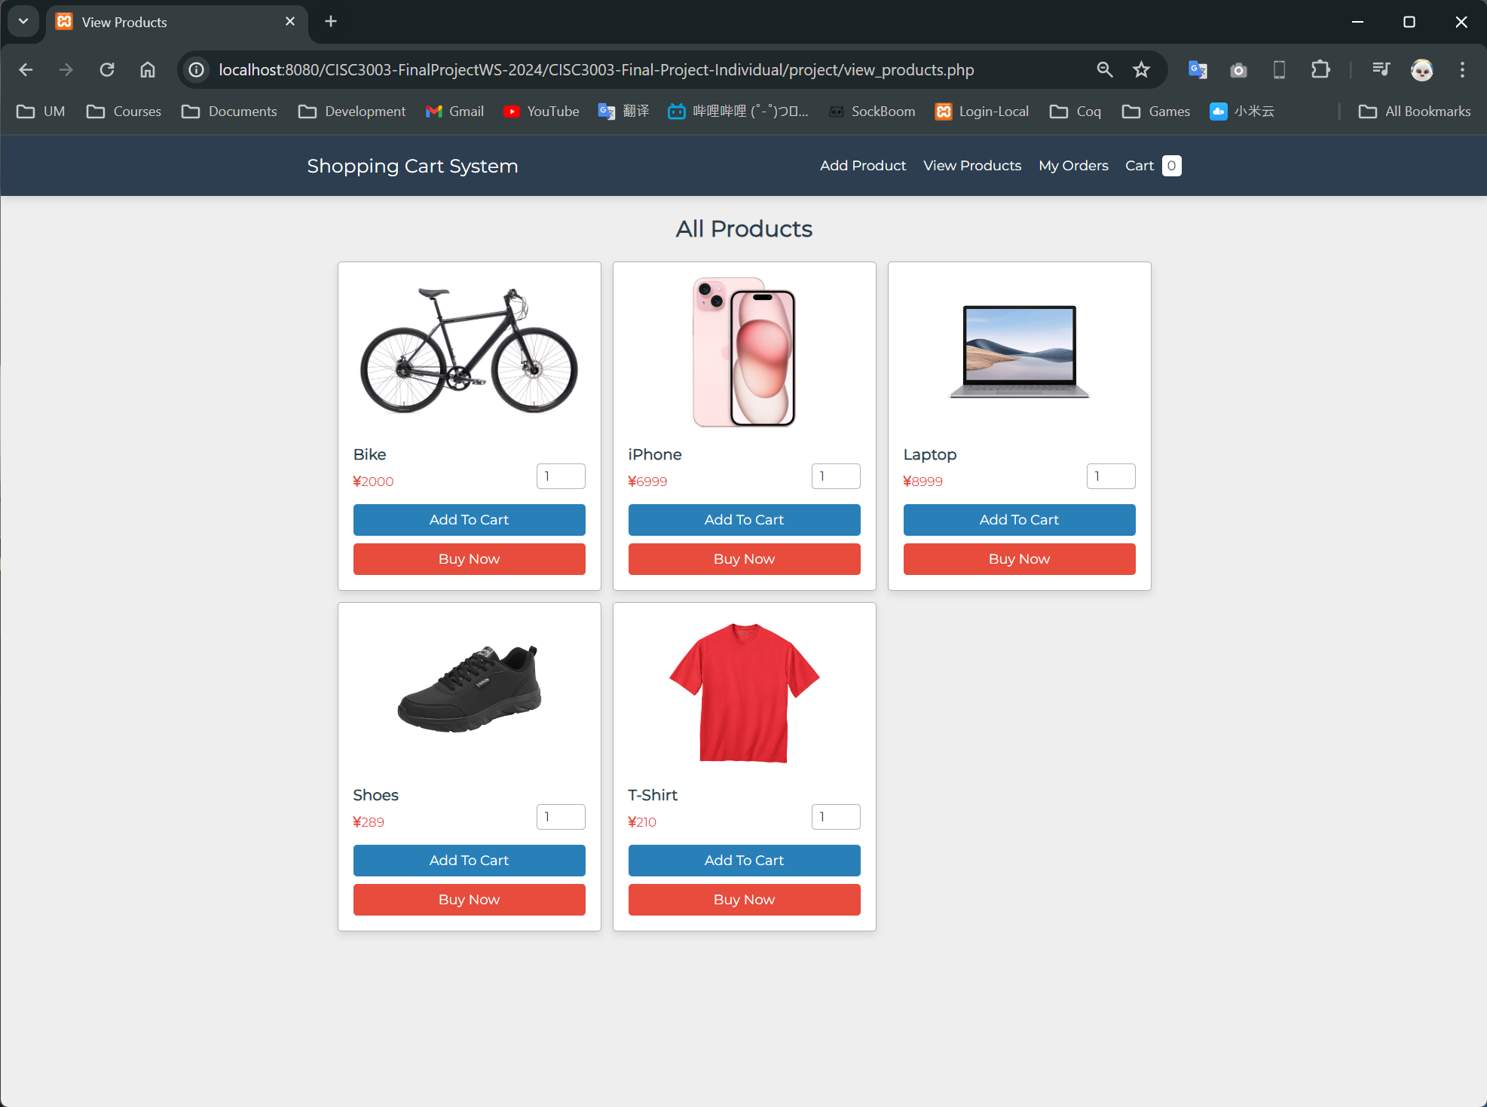
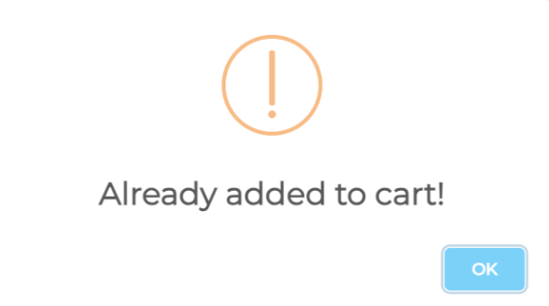
Functions / View Products
All the available products are listed in this page
A user can:
Specify the quantity of products he/she wants to buy
Add a product into shopping cart
Alternatively, directly place an order
Exception:
If the user tries to add a product that’s already in the shopping cart, an alert will be invoked.

Slide 5
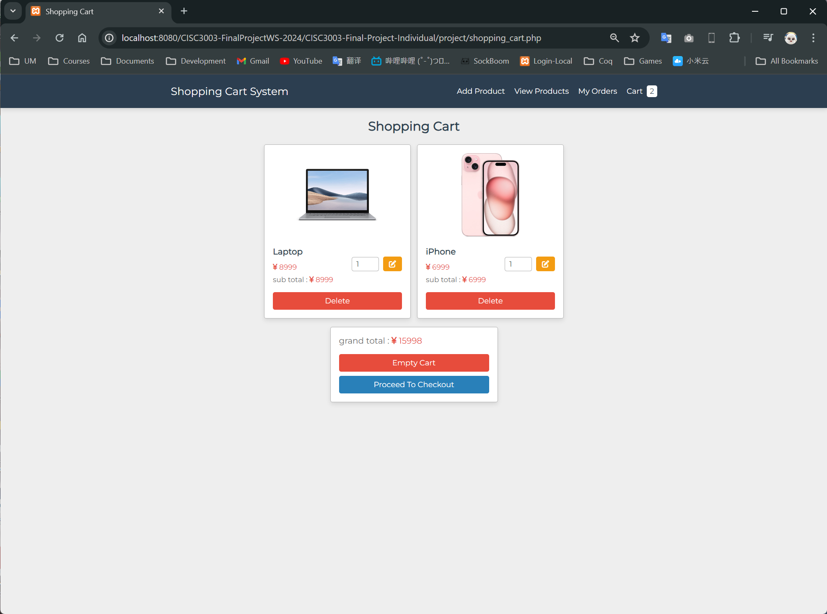
Functions / Shopping Cart
Shopping cart is a list of products a user decides to buy but didn’t buy immediately
A user can:
Remove the added product
Modify the quantity of a product
Empty the shopping cart
Proceed to make purchase

Slide 6
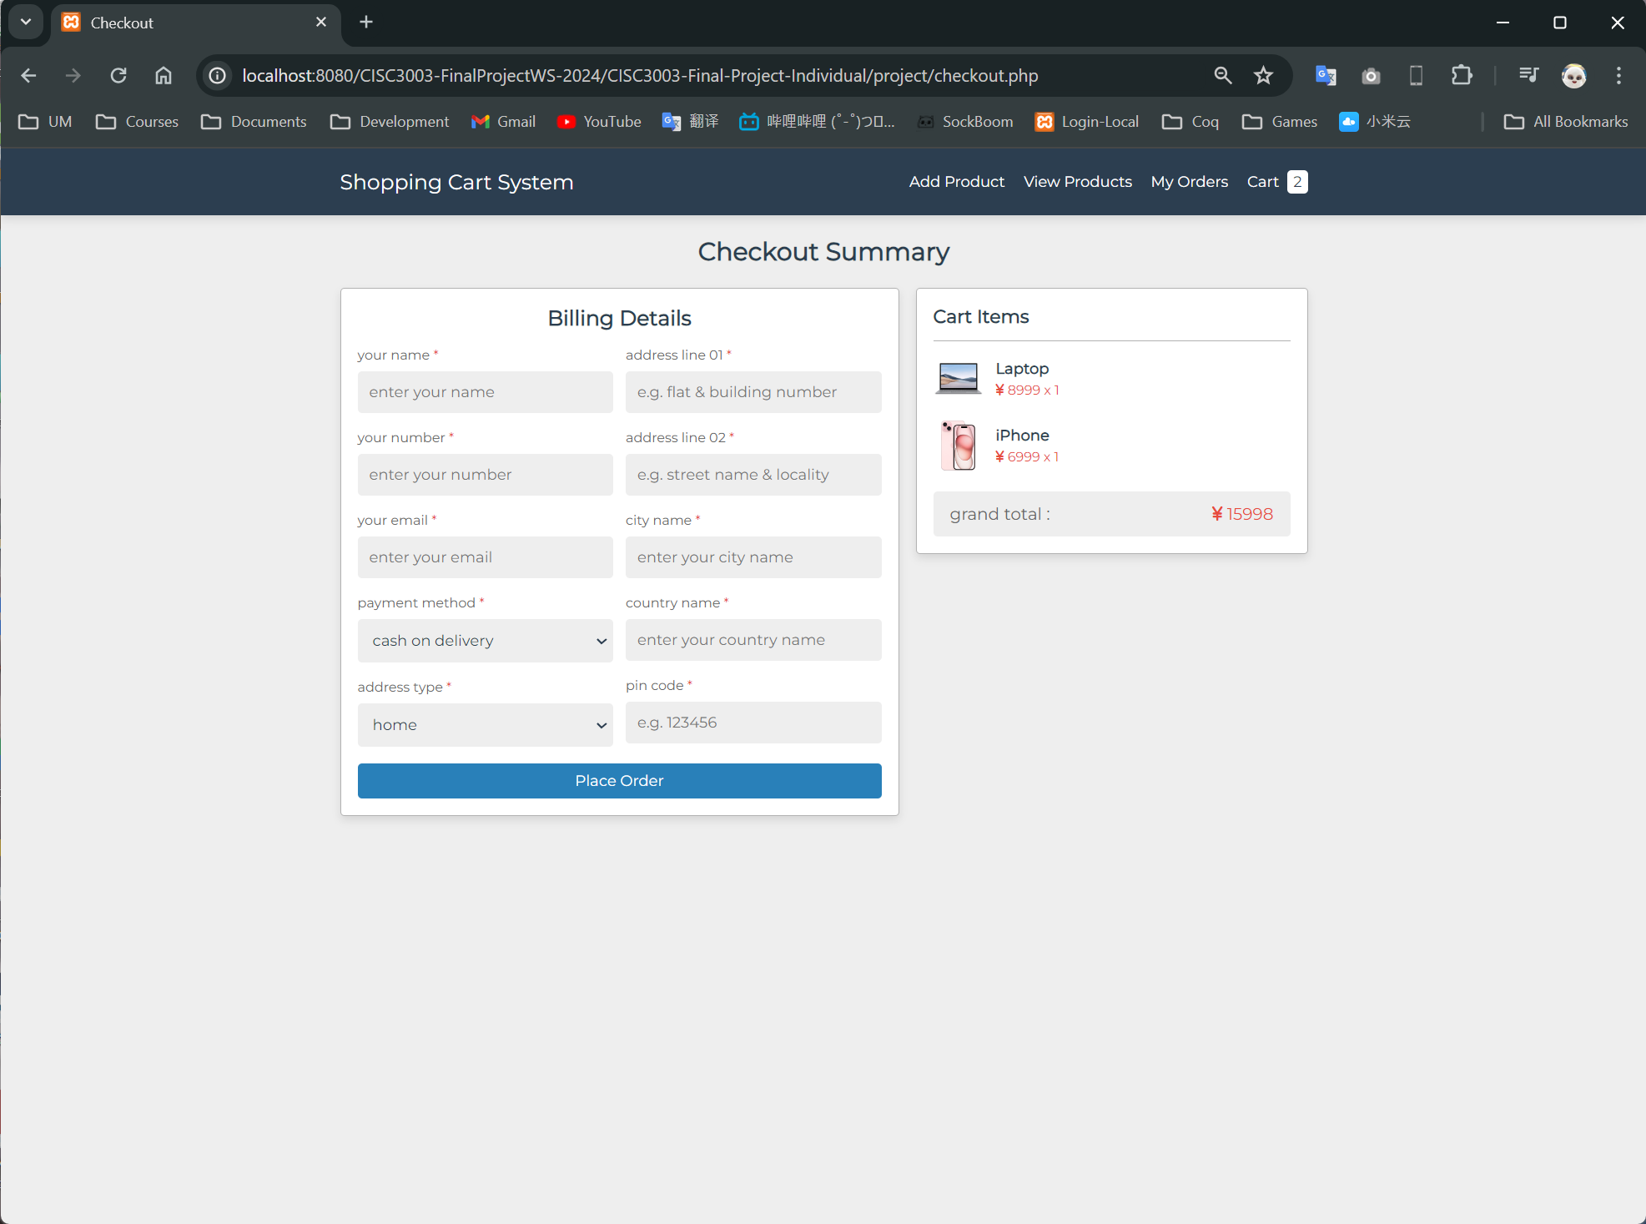
Functions / Checkout
A user places an order with detailed information in checkout
A user needs to specify:
Name
Addresses & Address Types
Phone number
Email
City & Country
PIN code

Slide 7
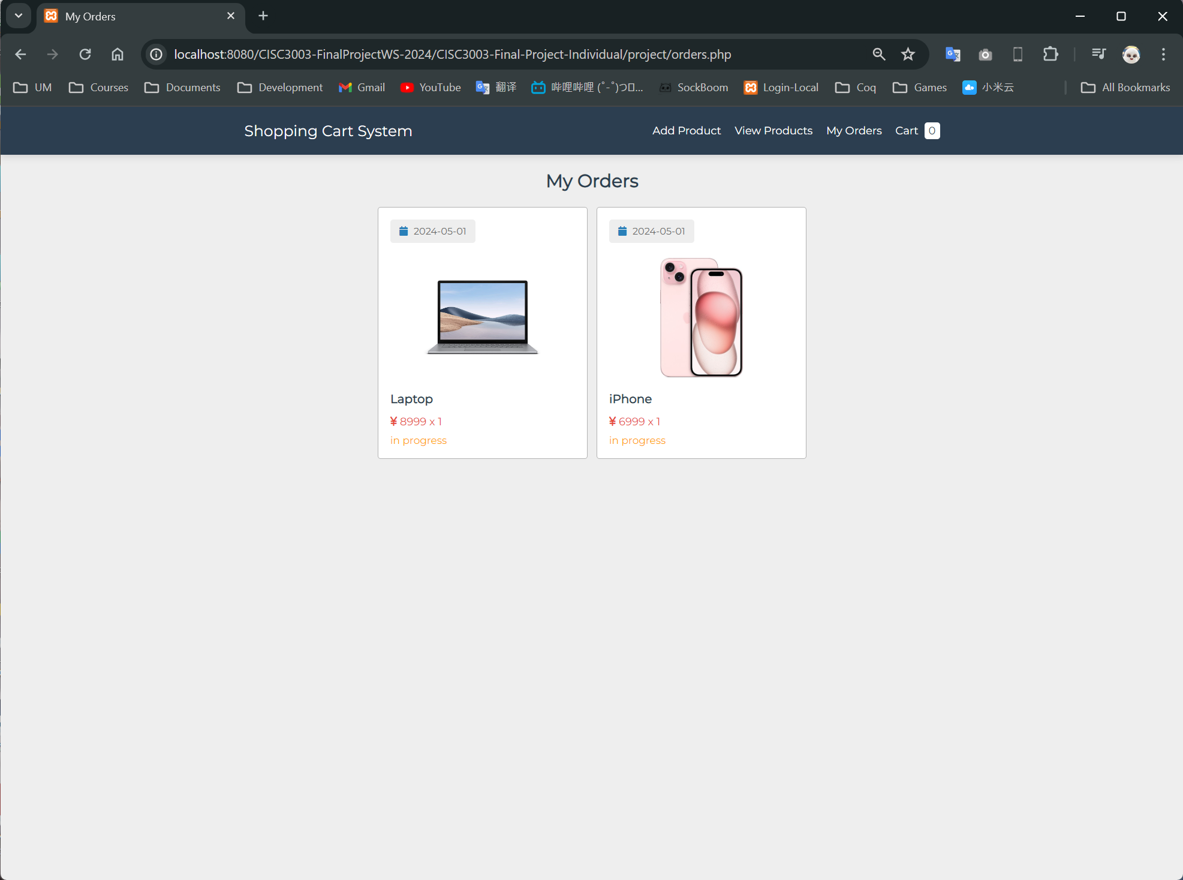
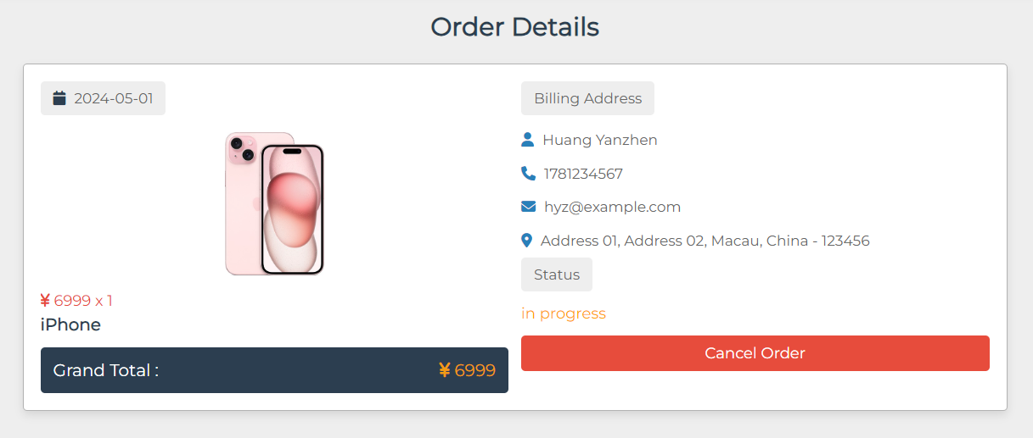
Functions / Orders
A user can view the orders they made in this page. Each product in the order have:
Date of purchase
Price
Order Status
By clicking into an order, a user can view the detailed information specified in checkout, as well as cancel the order.

Slide 8
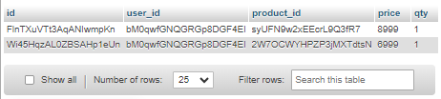
Database / Products
The most primary table is products. Product is the core of this database.
Each product is determined by a unique product id, being the primary key of the table.
Other than the product ID, we have product name, product price, and so on.
We also have the product image file name.

Slide 9
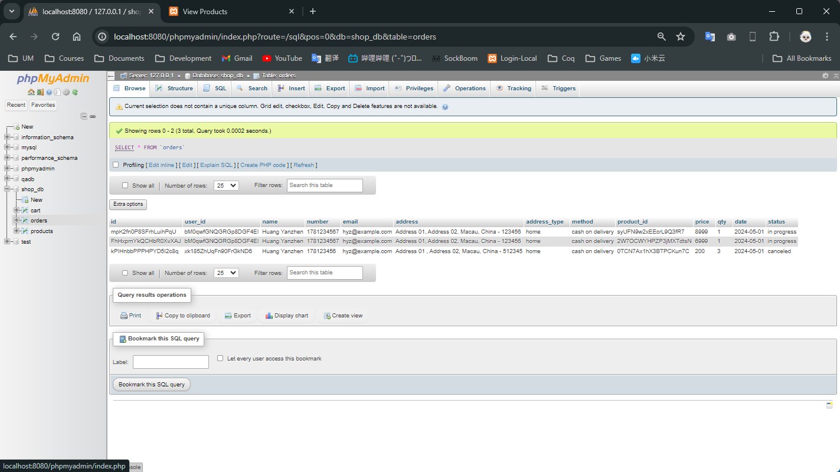
Database / Cart
In the cart table, we only need to specify which product is put into which user.
A product can be put into the cart by multiple users,
A user can put multiple products into the cart.
Therefore, it is better to use another primary key, the id, to identify each row.

Slide 10
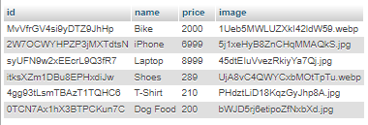
Database / Orders
Just like cart, orders table also have the many-to-many relationship of users and products.
However, we have some additional information stored, including
user name,
number,
email,
…
An additional ID is also used to identify each order record.

Slide 11
Thanks for Watching!

